Slide 1
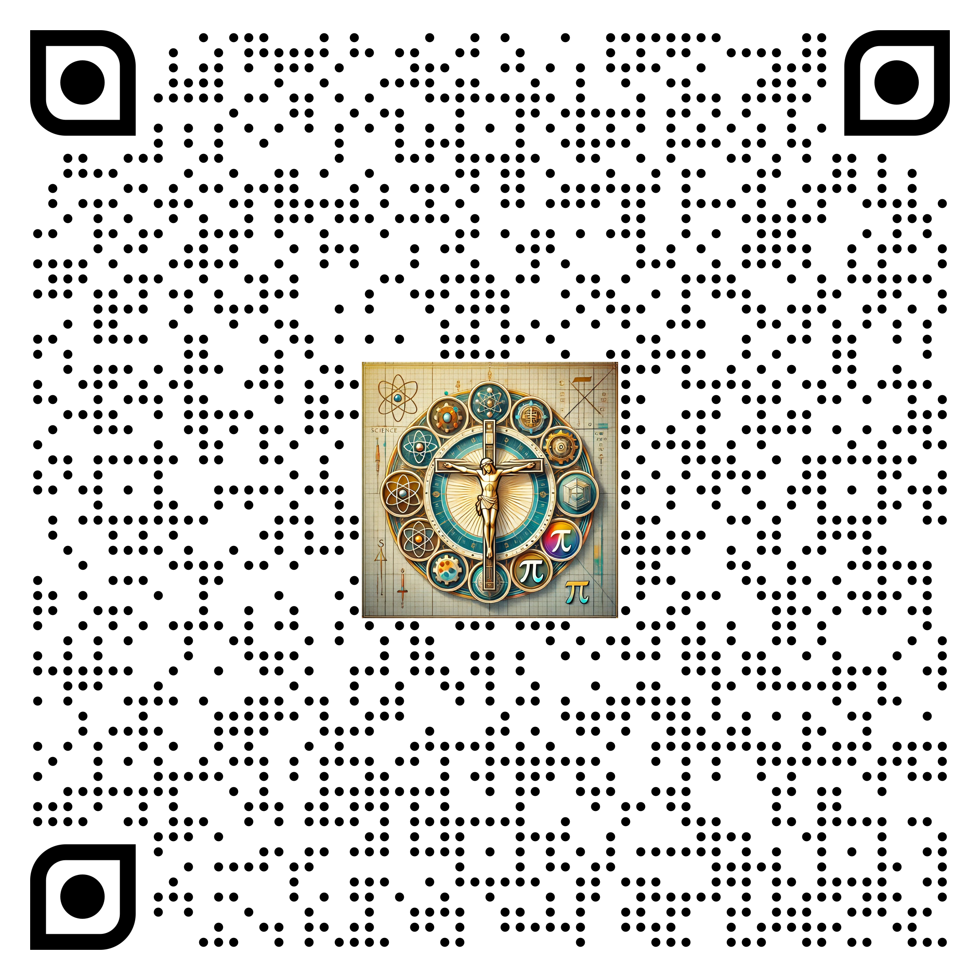
Mission to Unlock the Cathedral Code
Mr. Vandermark's C-STEM Escape Room 2025
Our Lady of the Prairie Catholic School
May 13, 2025

Slide 2

